Slide 1
MISTRALIS Outdoor Training
Theoretical and practical
lessons on the
basic principles
of navigation

Slide 2
Introduction
What is navigation?
It’s to conduct or steer a boat from a determinate location to another one.
Ideally with safety and economy.
The shortest way represents, in most of the cases, lower costs and a quickest trip.
In sailboats, the shortest way isn’t always possible, as we have to adapt to the wind direction and weather conditions.

Slide 3
Basic Vocabulary Positions
Bow (proa) – Stern (popa)
Larboard/ portside – Starboard (boreste)
/ port

Slide 4
Basic Vocabulary Structure and general definitions
Rudder (leme) – Keel (quilha)

Slide 5
Basic Vocabulary Structure and general definitions
Snatch blocks (patescas) Blocks (moitões)
Winch handle (manicaca) Winch (catraca)

Slide 6
Basic Vocabulary Sail Rig
Foot (esteira)
Leech (valuma) – Luff (testa)
Mast (mastro)
Boom (retranca)
head
clew
tack

Slide 7
MISTRALIS
Sailboat starts sailing

Slide 8
Basic Vocabulary Maneuver
Leeward (sotavento) – Windward (barlavento)

Slide 9
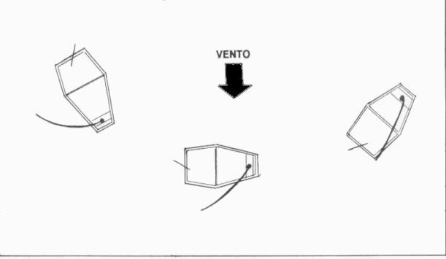
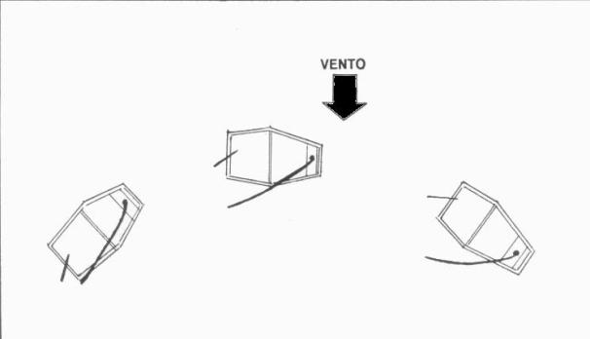
Basic Vovabulary Maneuver
Luffing (orçar)
when a sailboat is heading upwind
Bearing away (arribar)
when a sailboat is heading downwind

Slide 10
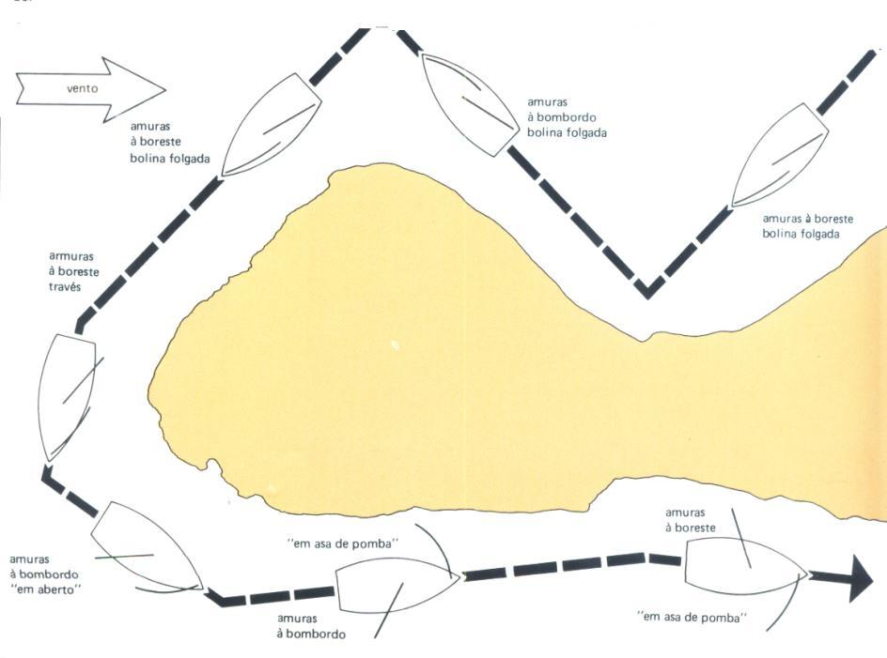
Basic Vocabulary Maneuver
Tacking (cambar)

Slide 11
Essential care to avoid collisions
Always manoeuver well ahead of time
If necessary invert engines to produce backward motion
In case of doubt always consider the risk of collision and manoeuver

Slide 12
Instruments for Navigation

Slide 13
Instruments for Navigation

Slide 14
Charts
Indicate our exact position on the surface of the earth, through latitude and longitude coordinates.
Represent, in a planisphere, a section of the surface of the earth.
With the help of the GPS terminal, we may know our exact position. All we need to do is plot our position on the chart.

Slide 15
Winds, tides and currents
They are the main factors that influence the navigation of any boat.

Slide 16
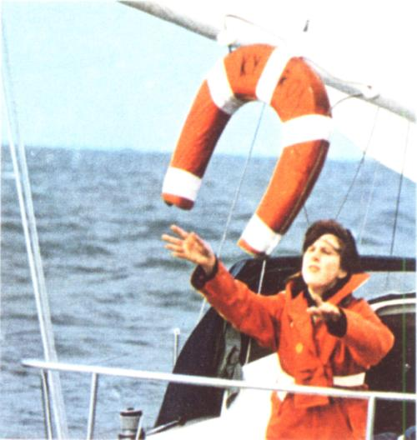
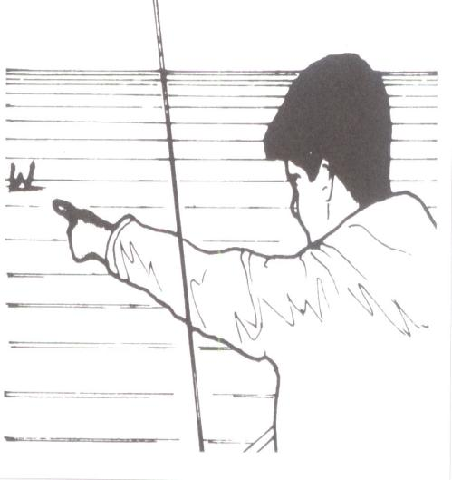
Man over board

Slide 17
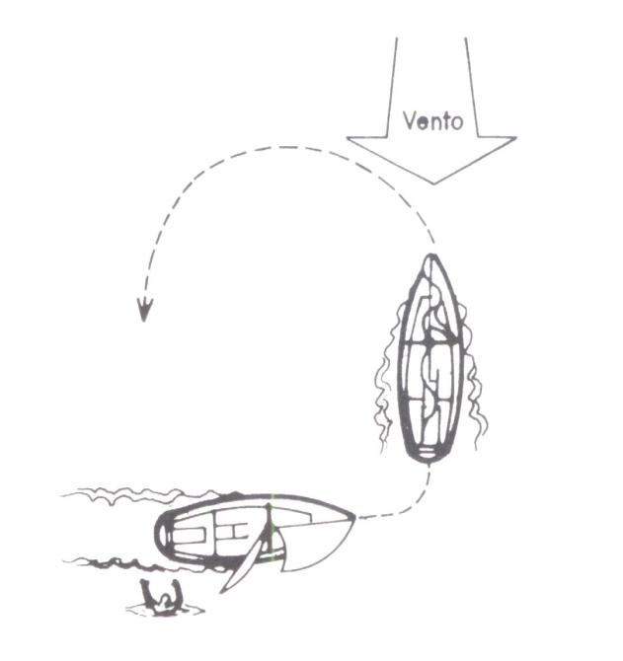
Man over board

Slide 18
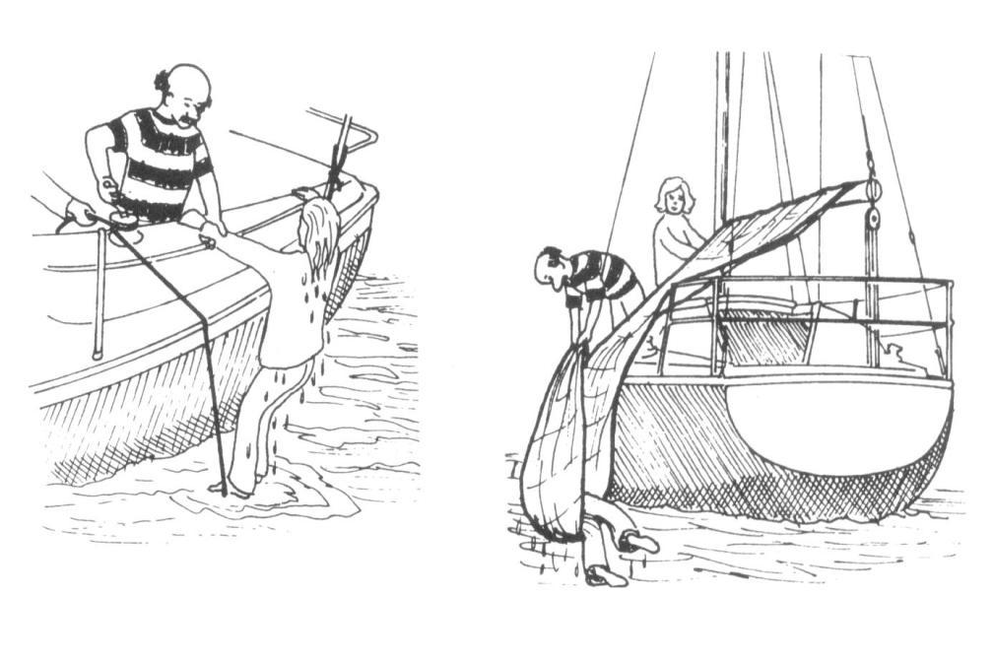
Man over board

Slide 19
Man over board

Slide 20
Step by step Reduced or inexperienced crew
1° Throw buoy on the water or any floating object
2° Designate a crew member to keep his eyes on the victim
3° Slow the boat down
4° Drop the sails of the bow
5° Turn back immediately to proceed rescuing
6° Pull the man onboard

Slide 21
MISTRALIS
Rest

Slide 22
Anchoring
We anchor to:
Get rest
Land / Go ashore
Take shelter

Slide 23
Anchoring
Some safety points to be thought out in anchoring
Consult the charts and verify tide oscilation, lowest depth and type of bottom
The aproach must be the slowest possible
Pay attention to boats in the área and the possible Wind rotation

Slide 24
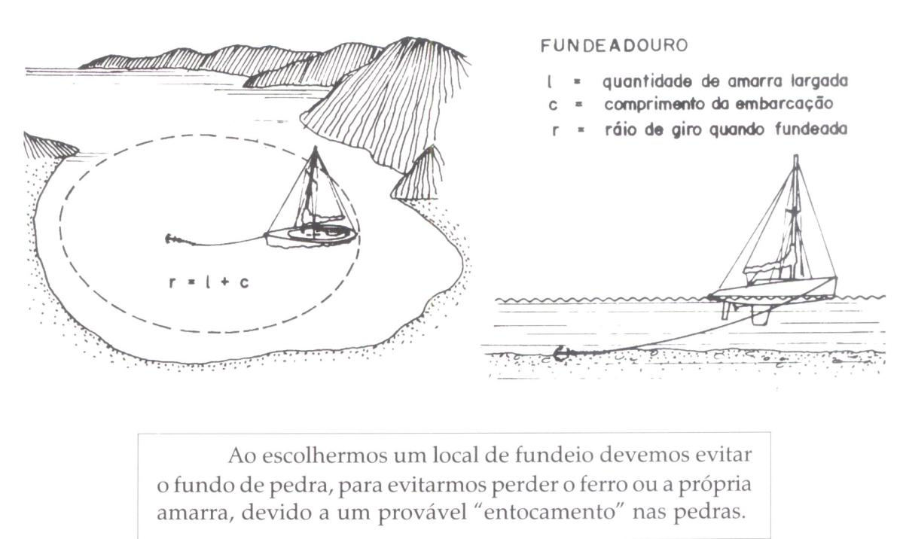
Anchoring

Slide 25
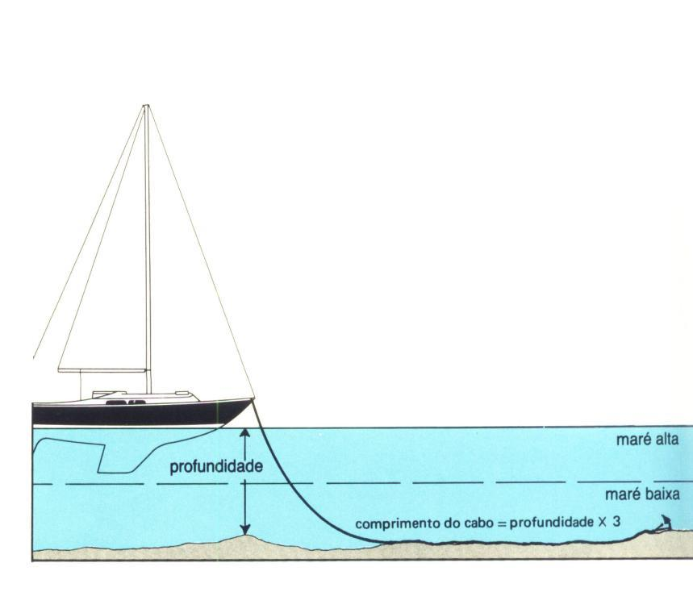
Anchoring

Slide 26
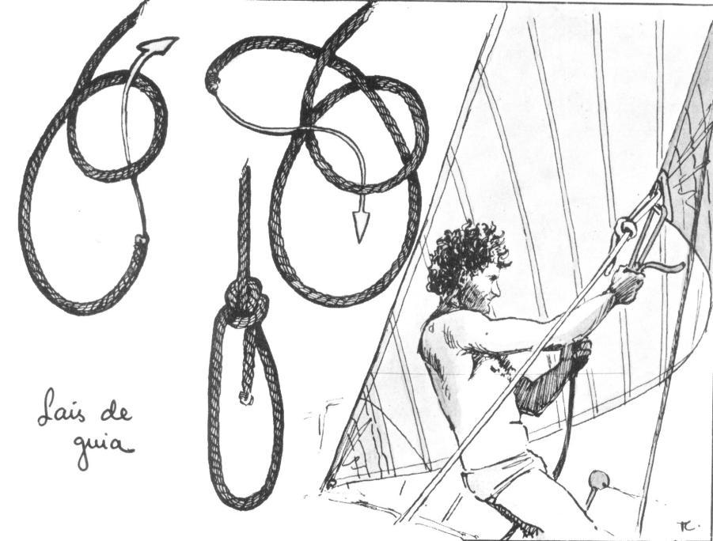
Knots

Slide 27
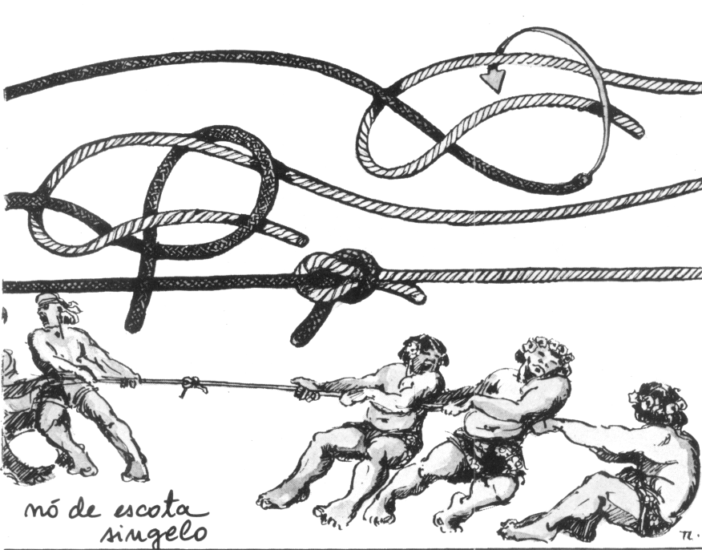
Knots

Slide 28
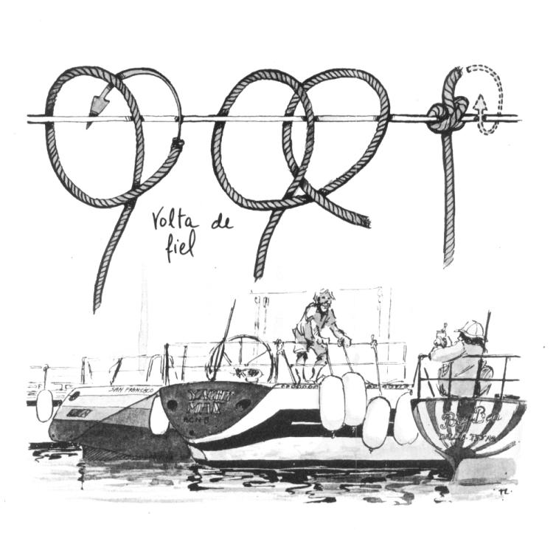
Knots

Slide 29
MISTRALIS
Have a good training,
a good sailing,
and
always good winds!!!

